Slide 1

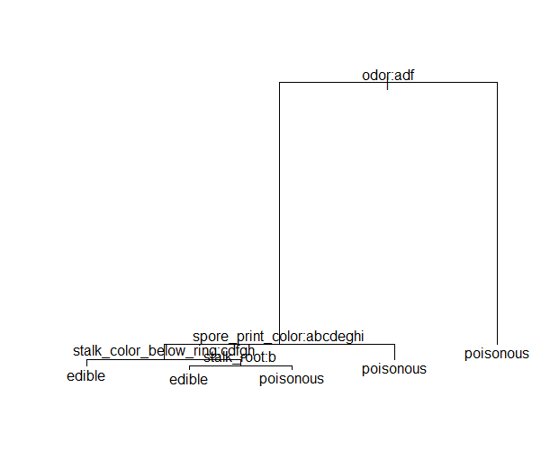
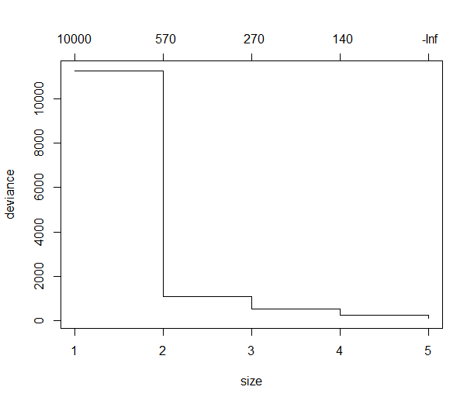
Mushroom Classification: Edible or Poisonous?
Leah Mathew 4th Year Data Science Student, University of the Sciences, Philadelphia PA
Basic Introduction + EDA
Mushroom dataset from UCI Machine Learning Repository
It is all categorical data, so we need to use classification to solve this
Data Cleanup started with renaming the columns, then renaming the levels of each variable
Changed all variables into factors for data modelling
Checked for Null Values (None)
Checked for redundant valuables (won’t be needed in final model)
Only one and its Veil Type so its removed
Methods
A. Classification Tree Model Fitting
B. Fitting of Pruned Model
C. K-Fold Validation + Holdout Before and After
Set up a train-test split
Pruned Tree happens first to see what the best fit is
Number of Nodes recommend by pruned tree: 5
Model should now be run with CV to see if it fares any better with the new node number
After pruning model, model is run again this time with the best number of nodes
After specifying the # of nodes, model runs better (less error)
Prediction tree before classified two poisonous as edible, but after using the pruned tree, model classifies two edible as poisonous
Misclassification Error Rate went down, signaling a better model
pred
edible poisonous
edible 1221 0
poisonous 2 1215
Accuracy : 0.9992
95% CI : (0.997, 0.9999)
No Information Rate : 0.5016
P-Value [Acc > NIR] : <2e-16
Kappa : 0.9984
Mcnemar's Test P-Value : 0.4795
Precision : 1.0000
Recall : 0.9984
F1 : 0.9992
Prevalence : 0.5016
Detection Rate : 0.5008
Detection Prevalence : 0.5008
Balanced Accuracy : 0.9992
'Positive' Class : edible
pruned.pred
edible poisonous
edible 1221 2
poisonous 0 1215
Accuracy : 0.9992
95% CI : (0.997, 0.9999)
No Information Rate : 0.5008
P-Value [Acc > NIR] : <2e-16
Kappa : 0.9984
Mcnemar's Test P-Value : 0.4795
Precision : 0.9984
Recall : 1.0000
F1 : 0.9992
Prevalence : 0.5008
Detection Rate : 0.5008
Detection Prevalence : 0.5016
Balanced Accuracy : 0.9992
'Positive' Class : edible
Classification tree:
tree(formula = edibility ~ ., data = train.set)
Variables actually used in tree construction:
[1] "odor" "spore_print_color"
[3] "stalk_color_below_ring" "stalk_root"
Number of terminal nodes: 5
Residual mean deviance: 0.01519 = 86.32 / 5681
Misclassification error rate: 0.001055 = 6 / 5686
Classification tree:
tree(formula = edibility ~ ., data = mushroom)
Variables actually used in tree construction:
[1] "odor" "spore_print_color"
[3] "stalk_color_below_ring" "stalk_root"
Number of terminal nodes: 5
Residual mean deviance: 0.01429 = 116 / 8119
Misclassification error rate: 0.0009847 = 8 / 8124
pred
edible poisonous
edible 1221 0
poisonous 2 1215
pruned.pred
edible poisonous
edible 1221 2
poisonous 0 1215
Only minor changes between precision and recall, but F-score is same between both which indicates that the model fits
Results and Discussion
Conclusions
Future Directions
Further studies would aim at classifying edibility but also special cases, as that would cover the true scope of whether the mushroom is edible or not
As the model suggest, five nodes works best for the data
The best classifiers are odor, spore print color, stalk color below ring, and stalk root
This can be seen in the deviances plot
As the size approaches five, the deviance goes to infinity, which shows that five nodes works best for the data
In the end, using the classification tree method helped to determine a model for classifying whether a mushroom is edible or poisonous
This model was successful in classifying almost all the predictions correctly, with only two errors total both times it was run
To rectify this, possibly running a function for catching errors could help to classify the edibility of the mushrooms better
References
Kaggle.com. 2021. Mushroom Classification. [online] Available at: <https://www.kaggle.com/uciml/mushroom-classification> [Accessed 20 December 2021].
Ryckel, F. de. (2017, November 19). Machine learning with R. Machine Learning with R. Retrieved December 20, 2021, from https://fderyckel.github.io/machinelearningwithr/case-study-mushrooms-classification.html
Professor Saghafi’s Codes

